Slide 1
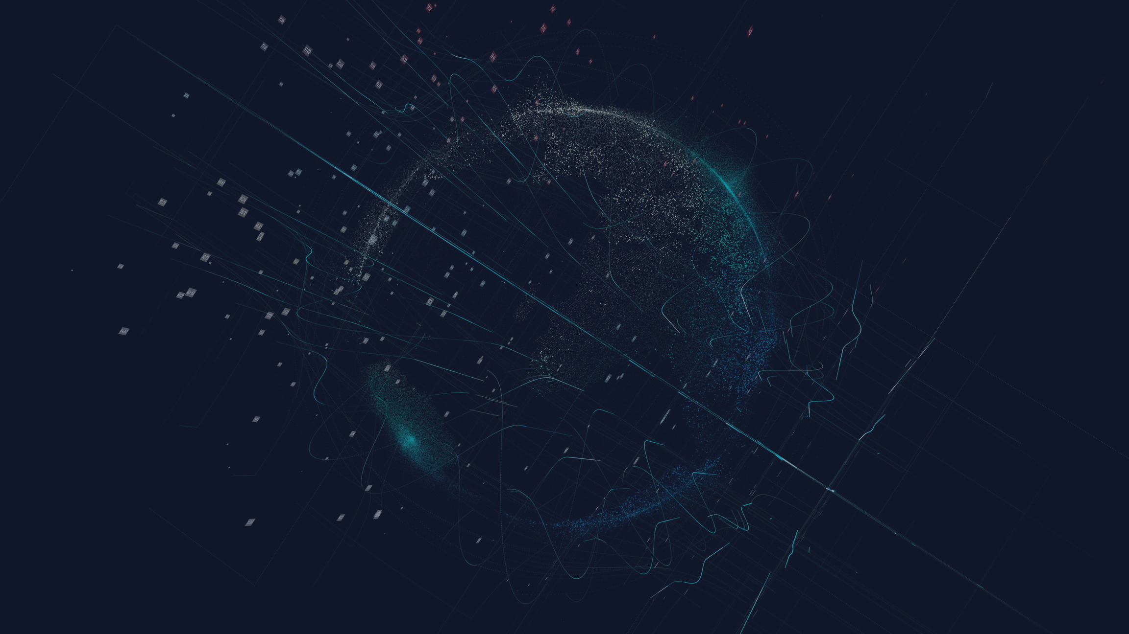

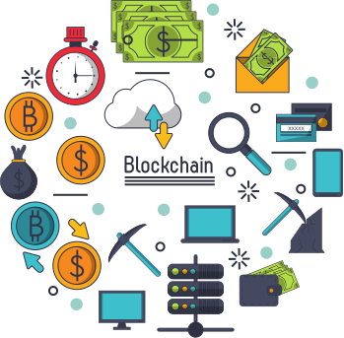
lockchain
TECHNOLOGY

Slide 2

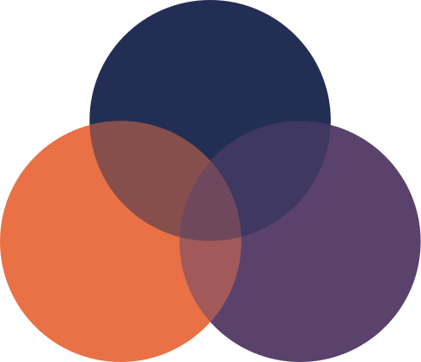
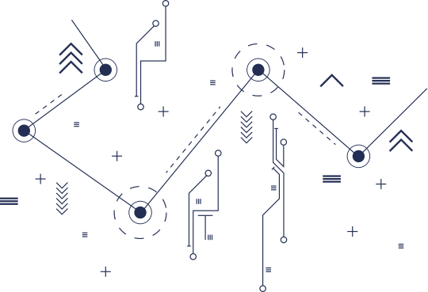

Web
WEB
The web is built on top of the internet, which is a global network of interconnected computers and servers that allows information to be transmitted across vast distances. The web allows users to access information in the form of web pages, which are written in languages such as HTML, CSS, and JavaScript, and are accessed using a web browser.
WEB 1.0
WEB
WEB 2.0
WEB 3.0

Slide 3


Technology
Reason
Domain Name System (DNS)
Hypertext
Transmission Control Protocol (TCP)
Internet Protocol (IP)
Information Sharing
WEB 1.0
(read only)
1991 - 2004
Users
Research Institutions
Goverment Bodies
The Military

Slide 4
1.
3.
An old internet that only allows people to read from the internet
Web is use as "information portal"
2.
4.
First stage World wide linking web pages and hyperlink
It uses table to positions and align elements on page
WEB 1.0

Slide 5
Technology
Reason
Adobe Flash Animation
Javascript and CSS
AI (early stage)
OpenAPIs
RSS
AJAX
Videos
Social Interaction
WEB 2.0
(read-write)
2005 - 2013
Users
Public Institutions
Private Institutions
Individuals

Slide 6
1.
3.
It is a platform that give users the possibility to control
their data.
Everyone can be content producer.
2.
4.
This is about user - generated content ond the reod-write web.
Web 2.O can be describe into 3 concepts which is ...
WEB 2.0

Slide 7
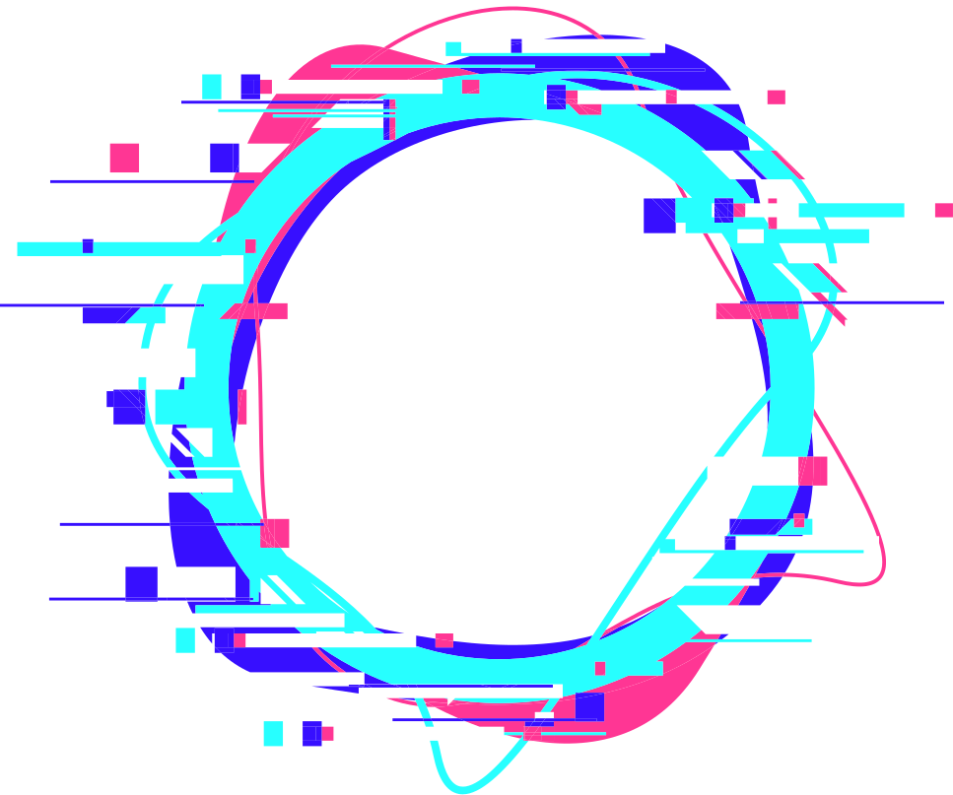




WEB 2.0 Concept
Rich lnternet
Application (RIA)
Service- Oriented
Architecture (SOA)
Social Web
It defines the experience brought from desktop to browser.
defines how web 2.0 applications expose its functionality so that other application can integrate the functionality and produce a set of much richer applications. (feeds, RSS)
it defines how web 2.0 tend to interact much more with the end user and making the end use an integral part

Slide 8
Technology
Reason
NFT
Advance AI
AR
Crypto
DApps
Decentralization
Automated Trust Enabler
WEB 3.0
(read-write-execute)
2014 -
Users
Public Institutions
Private Institutions
Individuals

Slide 9
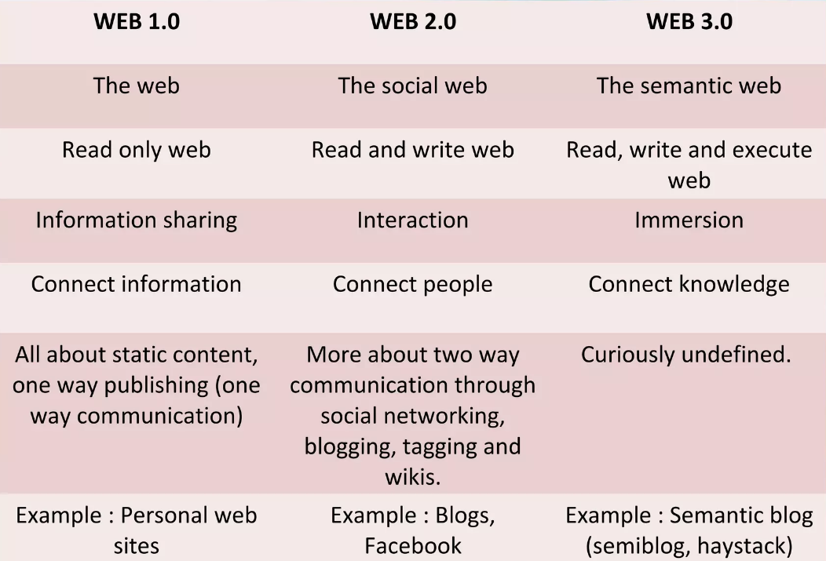

Slide 10
What is Blockchain?

Slide 11
Blockchain Core Values
1.
Decentralization
2.
Censorship Resistance
3.
Immutability
4.
Trustlessness
5.
Transparency

Slide 12
Problems with money
1.
Can't Represent Value
2.
Centralized
3.
Trust Intermediary
4.
Central Point of Failure
5.
Manipulate Balance
6.
Print More

Slide 13
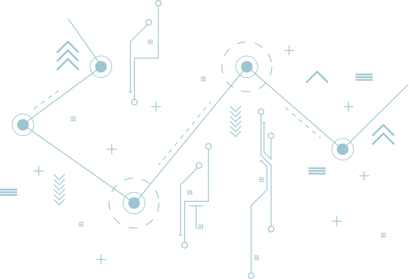
Trustless: No Intermediaries
Decentralized: No central point of Failure
Censorship Resistant: Cannot manipulate Balance
Immutable: Cannot print more
Solution: Blockchain

Slide 14
Example
CryptoCurrency
NFT (Non-Fungible Token)

